Slide 1
Accreditation, viability and continuous improvement
CEASD Conference
Hartford, Ct.
April 28, 2012
Claire Bugen
and
Joe Finnegan

Slide 2
What we are doing today…
Brief overview of the CEASD Protocol
Based on Middle States Accreditation For Growth (AFG)
Presentation of the CEASD/AFG Standards
Timeline for the process
Role of the Visiting Committee
A Plug to recruit more site visitors

Slide 3
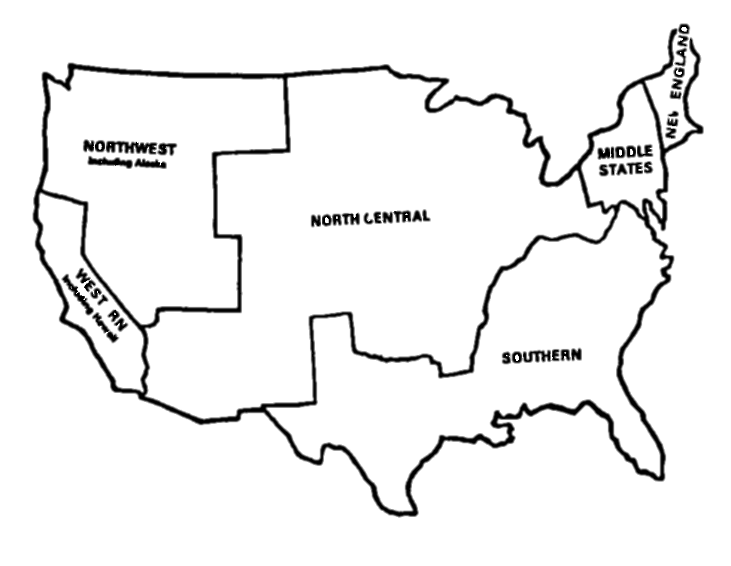
What is the CEASD Accreditation for Growth protocol?
Based on Middle States Association AFG
The MSA is just one of several accrediting associations in the US
Notes:
North Central, Northwest and Southern Associations all gone to Advanced-ED Standards

Slide 4
What is Advanced?
Global accreditation standards
Also a School Improvement Model
Currently Seven Standards
Vision and Purpose
Governance and Leadership
Teaching and Learning
Documenting and Using Results
Resources and Support Systems
Stakeholder Communication and Relationships
Commitment to Continuous Improvement
Only Five Standards as of 2012-2013
Purpose and Direction
Governance and Leadership
Teaching and Assessing for Learning
Resources and Support Systems
Using Results for Continuous Improvement

Slide 5
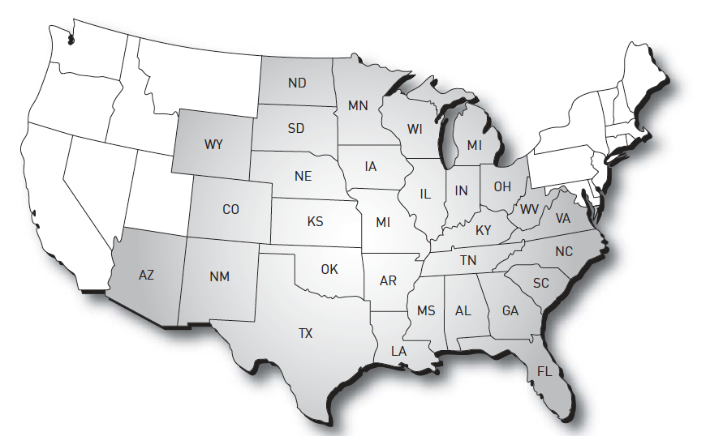
North Central, SACS and Northwest Have gone to AdvancEd
Northwest recently joined AdvancED and now includes the following states:
Alaska
Idaho
Montana
Nevada
Oregon
Utah Washington

Slide 6
Accreditation = Continuous Improvement
Notes:
What all the school improvement processes have in common.

Slide 7
The Self-Study Process at a Glance
Analysis of the school using the 12 CEASD Standards and Regional Standards
Identification of strengths and opportunities for growth from the analysis
Formulation of student and organization goals based on the analysis
Adherence to the requirements of the CEASD AFG protocol and Regional Protocol

Slide 8
What are the 12 CEASD Standards
Philosophy/Mission
Governance and Leadership
School Improvement Planning and Viability
Finances
Facilities
School Climate and Organization

Slide 9
What are the 12 CEASD Standards
Health and Safety
Educational program
Assessment and Evidence of Student Learning
Student Services
Student Life, Student Activities, and Residential Living
Learning Resources and Information Technology

Slide 10
Standards
A standard represents a statement of quality practices and conditions that research and best practice indicate are necessary for schools to achieve quality student performance and organizational effectiveness.

Slide 11
Indicators
Indicators are operational definitions or descriptions of exemplary practices and processes. Together, the indicators provide a comprehensive picture of each standard.

Slide 12
To be accredited, our member schools must:
Meet the CEASD Accreditation Standards
Engage in continuous improvement
Demonstrate quality assurance through a peer review site team visit
Notes:
1.The standards require that the district and its schools have a clear vision and purpose; have effective and responsive leadership; have a rigorous curriculum taught through sound, research-based methods; collect, report, and use performance results; provide adequate resources and support for its educational programs; and value and communicate with their stakeholders.
2. To demonstrate continuous improvement, the district and its schools must implement an improvement plan based on student performance and school/community data that includes clear goals for raising the achievement of all students. The district and its schools also must document growth in student performance and organizational effectiveness.
3. Districts must be evaluated by a team of professionals from outside the district on a periodic basis. The team engages the district staff in a healthy, professional dialogue about district improvement efforts, validates that the district meets the standards for accreditation, and provides feedback and makes recommendations concerning future efforts to improve student performance and organizational effectiveness.

Slide 13
What is the organizing structure for conducting the self-study
Varies—some protocols more prescriptive than others
Typically one large planning team, sometimes with prescribed internal coordinators, representatives from each part of the school
Action Teams, or Goal Teams, or Standards Teams—whatever group documents and writes report on that Standard or goal
As inclusive as possible

Slide 14
Timelines
Minimum of one to one and a half years of self-study plus
Sample Organizational Timeline/Schedule

Slide 15
Timelines
Beginning date of the self-study.
Deadline for preliminary data and documentation gathering.
Meetings dates of steering and subcommittees.
Dates for completion of the committee reports.
Final date for review and reading of committee reports.
Final date for completion of self-study report.
Date for completing the final review of the self-study report.
Schedule of final visit of consultant to verify school is ready for visit.
Target date for sending final draft to visiting committee chair.
Mailing of self-study at least three weeks prior to the team visit.
Scheduled visit of the visiting accreditation team.

Slide 16
Final Self-Study Document
Should tell a story
Context of the School
Standards for Accreditation
Planning Process
Content of the School Improvement Plan
Due four to six weeks prior to the on-site visit

Slide 17
Selection of the Visiting Team
National Office and Accreditation Chair
Limited input from School
Three to Five Members depending on size of school and Regional Team

Slide 18
What happens during the visit?
Artifacts and Exhibits that relate to Standards
Schedule approved by the Chair and School
Three and a half day visit
Typically Sunday through Wednesday
Team conducts interviews with administrative leaders, staff, students, parents and other stakeholders, makes professional observations, examines artifacts

Slide 19
What happens during the visit cont’d?
Team engages in professional deliberations
Reaches consensus on standards, commendations, recommendations including an accreditation recommendation.
Creates and presents an oral exit report
Formulates and submits a written report

Slide 20
The Team Depends On
Data ➔ Information ➔ Evidence
Interviews
Observations
Artifacts

Slide 21
What is evidence…
Evidence is factual information that is not influenced by opinion or personal preference
Sources of Evidence
Assessments, achievement data, exit data, observation data, interview data, participation data, survey data
Artifacts documents, communications, materials, records
Evidence Must Be
Fair, honest, free of bias reliable: consistent, representative valid: relevant, matched to standard

Slide 22
Classroom/Dorm Observations
Very important to CEASD
Varies among regional teams
Purpose to corroborate self-study or information gained through interviews

Slide 23
Exhibits or Artifacts
KISS Principle
Organized
Easy to manage
ORGANIZED BY STANDARD

Slide 24
The Visit ends with an Oral Exit Report
High level summary
Some observations about the school’s process
Thank Yous
Sample Commendations and Recommendations
What accreditation status the team will recommend to their respective governing authorities

Slide 25
How the Final Written Report is assembled
Introduction about the Context of the School
Summary of Findings/Observations related to the Standards
Commendations and Recommendations
Sample evidence relied on
Conclusion
Next Steps

Slide 26
The Visiting Team Experience
Intense
Collaborative
Stimulating
Intellectual
Exhausting ☹

Slide 27
serving on a team
WHO:
Experienced professional educators from a variety of backgrounds, including retired educators
WHY:
You learn about new strategies, approaches and practices
Provide insights as fellow educator
Demonstrate your professional commitment to quality education

Slide 28
What is your role on the visiting Team?
Affirm the findings of the self-study
Being a “critical friend” and colleague not a critic or consultant
Leaving the school more prepared to move forward with purpose and expanded capcity for improvement
Making sure your observations are rooted in evidence

Slide 29
Role of the Team Chair
To consistently implement the accreditation protocol
Supervise the conduct of team members
Communicate directly with organization staff with emerging issues or concerns
Guide the team in developing a schedule and reaching consensus on the accreditation recommendation and findings
Completing and submitting the final report

Slide 30
Assessing the School’s ability to meet the Standards
Review data collected from:
Staff, Parents, Students, Others
Reviewing the Self-Study report on Standard
Reviewing the evidence to support the assessment of standards
Conducting Interviews and observations

Slide 31
Team looks at the Planning Process
Diverse Membership
Meeting schedules, agendas, notes
Interface with other school improvement/leadership teams
Communication and transparency of the planning process
Steering Committee’s role
Role of Action/Implementation Teams

Slide 32
Team looks at Content of the Self Study
Mission
Beliefs
Some regionals require Profile of the Graduate
Documents/Surveys to support the School’s Internal and External Scan
How did they influence the School Improvement/Action Plans

Slide 33
A Team’s Accreditation Recommendation is Based on
Meeting the applicable CEASD and Regional Standards
Developing a Maintaining a Process for Continuous Growth and Improvement in Student Performance and Organizational Capacity
Having a Plan for Growth and Improvment

Slide 34
A Team may Recommend
Accreditation
Provisional Accreditation
No Accreditation
Regionals have varied Recommendations e.g. Accreditation with Stipulations, etc.

Slide 35
A Team’s Accreditation Recommendation is reviewed by…
CEASD Board of Directors
Regional Commissions

Slide 36
Team Writing Assignments
Decided by the Chair
Template available
Use Self-Study and support with narrative based on Observations and Evidence
Team Chair decides how Oral Exit Report will be handled
Team Chair is responsible for final written report

Slide 37
Team responsibilities during the visit…
Bring problematic standards or indicators to the attention of the chair
Include quotes when possible in your written narrative
Refer to the evidence reviewed, interviews and observations

Slide 38
Oral Report
20 minutes in length
School decides who will attend and where it will be delivered
It includes highlights of the visit
Areas of strength
Areas in which the school faces challenges
Includes the team’s accreditation recommendation

Slide 39
Questions and Answers

