Slide 1
Accreditation, Viability and Continuous Improvement
A Guide for Accreditation Teams
CEASD Conference
Hartford, Ct.
April 28, 2012
Revised August 2016
(logo added 2019)
Claire Bugen
and
Joe Finnegan

Slide 2
Today’s Agenda
Brief overview of the CEASD Protocol
Based on Middle States Accreditation For Growth (AFG)
Presentation of the CEASD/AFG Standards
Timeline for the process
Role of the Visiting Committee
A Plug to recruit more site visitors

Slide 3
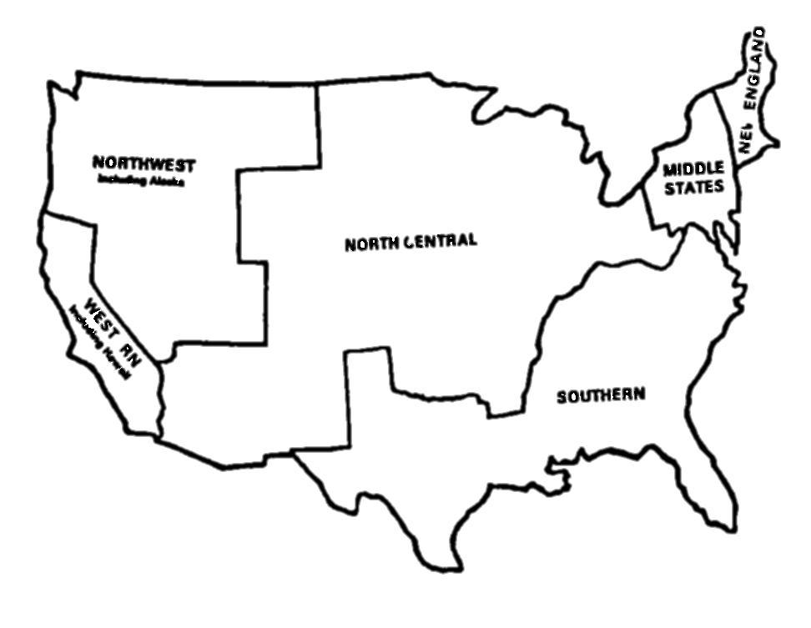
The CEASD Accreditation for Growth Protocol
Based on Middle States Association AFG
The MSA is just one of several accrediting associations in the US
Notes:
North Central, Northwest and Southern Associations all gone to Advanced-ED Standards

Slide 4

What is AdvancED?
Global accreditation standards
Also a School Improvement Model
  North Central, SACS and
  Northwest have adopted
  AdvancED accreditation Standards.
Five Standards for Quality
  Purpose and Direction
  Governance and Leadership
  Teaching and Assessing for Learning
  Resources and Support Systems
  Using Results for Continuous Improvement

Slide 5
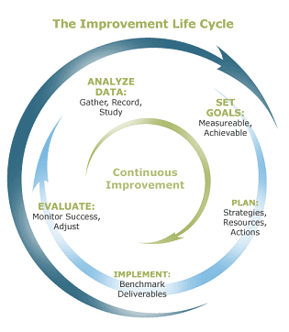
Accreditation =
Continuous Improvement
Notes:
What all the school improvement processes have in common.

Slide 6
The Self-Study Process at a Glance
Analysis of the school using the 12 CEASD Standards and Regional Standards.
Identification of strengths and opportunities for growth from the analysis.
Formulation of student and organization goals based on the analysis.
Adherence to the requirements of the CEASD AFG protocol and Regional Protocol.

Slide 7
The 12 CEASD Standards
Philosophy/Mission
Governance and Leadership
School Improvement Planning and Viability
Finances
Facilities
School Climate and Organization

Slide 8
The 12 CEASD Standards Contd.
Health and Safety
Educational program
Assessment and Evidence of Student Learning
Student Services
Student Life, Student Activities, and Residential Living
Learning Resources and Information Technology

Slide 9
Standards
A standard represents a statement of quality practices and conditions that research and best practice indicate are necessary for schools to achieve quality student performance and organizational effectiveness.

Slide 10
Indicators
Indicators are operational definitions or descriptions of exemplary practices and processes. Together, the indicators provide a comprehensive picture of each standard.

Slide 11
Requirements for Accreditation
Meet the CEASD Accreditation Standards.
Engage in continuous improvement.
Demonstrate quality assurance through a peer review site team visit.
Notes:
1.The standards require that the district and its schools have a clear vision and purpose; have effective and responsive leadership; have a rigorous curriculum taught through sound, research-based methods; collect, report, and use performance results; provide adequate resources and support for its educational programs; and value and communicate with their stakeholders.
2. To demonstrate continuous improvement, the district and its schools must implement an improvement plan based on student performance and school/community data that includes clear goals for raising the achievement of all students. The district and its schools also must document growth in student performance and organizational effectiveness.
3. Districts must be evaluated by a team of professionals from outside the district on a periodic basis. The team engages the district staff in a healthy, professional dialogue about district improvement efforts, validates that the district meets the standards for accreditation, and provides feedback and makes recommendations concerning future efforts to improve student performance and organizational effectiveness.

Slide 12
Organizational Structure for the Self-study
Varies—some protocols more prescriptive than others.
Typically one large planning team, sometimes with prescribed internal coordinators, representatives from each part of the school.
Action Teams, or Goal Teams, or Standards Teams—whatever group documents and writes report on that Standard or goal.
As inclusive as possible.

Slide 13
Timelines
Minimum of one to one and a half years of self-study.
Sample Organizational Timeline/Schedule.

Slide 14
Timelines
Deadline for preliminary data and documentation gathering.
Meeting dates of steering and subcommittees.
Dates for completion of the committee reports.
Final date for review and reading of committee reports.
Final date for completion of self-study report.
Date for completing the final review of the self-study report.
Target date for making final suggested changes to the self-study.
Scheduled visit of the visiting accreditation team.
National Office sent self-study to verify school is ready for the visit (8 weeks before visit)
Mailing and/or e-mailing self-study at least six weeks prior to the team visit.
Beginning date of the self-study.

Slide 15
Final Self-Study Document
Should tell a story
  Context of the School
  Standards for Accreditation
  Planning Process
  Content of the School Improvement Plan
  Due 8 weeks prior to the on-site visit to the National Office.
  Sent 4-8 weeks prior to the on-site visit to the Visiting Team.

Slide 16
Selection of the Visiting Team
National Office and Accreditation Chair
Limited input from School
Three to five members depending on size of school and Regional Team

Slide 17
Components of the Site Visit
Artifacts and Exhibits that relate to Standards
Schedule approved by the Chair and School
Three and a half day visit
Typically Sunday through Wednesday
Team conducts interviews with administrative leaders, staff, students, parents and other stakeholders, makes professional observations, examines artifacts.

Slide 18
Components of the Site Visit Contd.
Team engages in professional deliberations.
Reaches consensus on standards, commendations, recommendations including an accreditation recommendation.
Creates and presents an oral exit report.
Formulates and submits a written report.

Slide 19
The Team Depends On
Data ➔ Information ➔ Evidence
Interviews
Observations
Artifacts

Slide 20
What is Evidence?
Evidence is factual information that is not influenced by opinion or personal preference.
  Sources of Evidence
    Assessments, achievement data, exit data, observation data, interview data, participation data, survey data
    Artifacts/documents, communications, materials, records
  Evidence Must Be
    Fair, honest, free of bias, reliable, consistent, representative, valid, relevant, matched to standard

Slide 21
Classroom and Dormitory Observations
Very important to CEASD
Varies among regional teams
Purpose to corroborate self-study or information gained through interviews

Slide 22
Exhibits or Artifacts
KISS Principle
Organized
Easy to manage
ORGANIZED BY STANDARD

Slide 23
Oral Exit Report Concludes Site Visit
High level summary
Some observations about the school’s process
Thank You’s
Sample Commendations and Recommendations
What accreditation status the team will recommend to their respective governing authorities. Some regional bodies do not announce the accreditation decision.

Slide 24

The Final Written Report
Introduction about the Context of the School
Summary of Findings/Observations related to the Standards
Commendations and Recommendations
Sample evidence used
Conclusion
Next Steps

Slide 25
The Visiting Team Experience
Intense
Collaborative
Stimulating
Intellectual
Exhausting

Slide 26
Serving on a Team
WHO:
  Experienced professional educators from a variety of backgrounds, including retired educators
WHY:
  You learn about new strategies, approaches and practices
  Provide insights as fellow educator
  Demonstrate your professional commitment to quality education

Slide 27
Role of a Team Member
Affirm the findings of the self-study.
Being a “critical friend” and colleague not a critic or consultant.
Leaving the school more prepared to move forward with purpose and expanded capacity for improvement.
Making sure your observations are rooted in evidence.

Slide 28
Role of the Team Chair
Consistently implement the accreditation protocol.
Supervise the conduct of team members.
Communicate directly with organization staff with emerging issues or concerns.
Guide the team in developing a schedule and reaching consensus on the accreditation recommendation and findings.
Complete and submit the final report.

Slide 29
Assessing the School’s Ability to Meet the Standards
Review data collected from:
  Staff, Parents, Students, Others
Review the Self-Study report on the Standards
Review the evidence to support the assessment of the Standards.
Conduct interviews and complete school and dormitory observations.

Slide 30
Team Review of the
Planning Process
Diverse Membership
Meeting schedules, agendas, notes
Interface with other school improvement/leadership teams
Communication and transparency of the planning process
Steering Committee’s role
Role of Action/Implementation Teams

Slide 31
Team Review of Self-Study Content
Mission
Beliefs
Some regionals require Profile of the Graduate
Documents/Surveys to support the School’s Internal and External Scan
How did data influence the School Improvement/Action Plans?

Slide 32
Basis for Team’s Accreditation Recommendation
Meeting the applicable CEASD and Regional Standards.
Developing and maintaining a process for continuous growth and improvement in student performance and organizational capacity.
Having a plan for growth and improvement.

Slide 33
Possible Recommendations
Accreditation
Provisional Accreditation
No Accreditation
Regionals have varied Recommendations e.g. Accreditation with Stipulations, etc.

Slide 34
Team’s Accreditation Recommendation Reviewed By…
CEASD Board of Directors
Regional Commissions

Slide 35
Team Writing Assignments
Decided by the Chair.
Template available.
Use Self-Study and support with narrative based on Observations and Evidence.
Team Chair decides how Oral Exit Report will be handled.
Team Chair is responsible for final written report.

Slide 36
Responsibilities of Team
Bring problematic standards or indicators to the attention of the chair.
Include quotes when possible in your written narrative.
Refer to the evidence reviewed, interviews and observations.

Slide 37
Oral Report
20 minutes in length
School decides who will attend and where it will be delivered.
It includes highlights of the visit.
Areas of strength
Areas in which the school faces challenges
May include the team’s accreditation recommendation.

Slide 38
QUESTIONS AND ANSWERS

